Slide 1

H172 35 - Object Oriented Analysis and Design
Initial Class Diagrams

Slide 2
Classes are made up of…
Attributes (used to describe the instance of the class)
Methods (to allow the class to “do” things)
Visibility (public or private)
Relationships (connections to other class)
These relationships could be:
Association (“speaks” to another class)
Aggregation (part of another class and but can exist without it) Songs are part of an album
Composition (part of another class and can’t exist without it)
Inheritance (parent / child relationship)
Multiplicity (how many are allowed to relate to each other)

Slide 3
Relationships
The two simplest types of relationships are:
Association - separate classes which communicate / talk to one another to do a task
Class Association Class
Bank validates Payment
Nurse dispenses Medication
Player plays Game
Inheritance - Classes with similar characteristics grouped under a common parent
A Nurse + a Doctor are types of Medical Staff

Slide 4
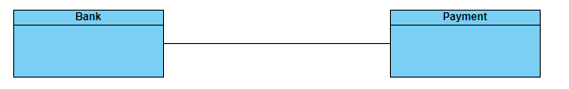
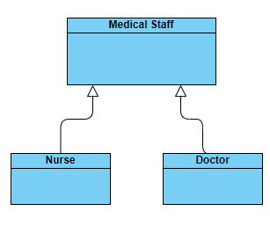
Relationships
Association
Inheritance

Slide 5
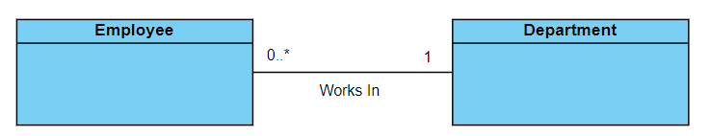
Multiplicity
Indicates how many objects can participate in a given relationship
Similar to Cardinality (one to many / one to one) in Databases
How many Departments does an Employee member work in?
Just 1
How many Employees does a Department have in it?
Anywhere from Zero to many / infinite

Slide 6
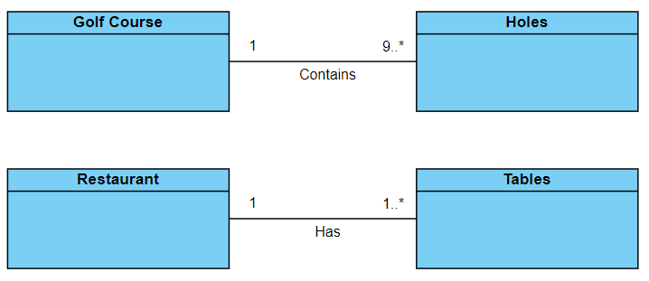
Common Multiplicity
1 exactly one
0..* zero or more (default)
1..* one or more

Slide 7
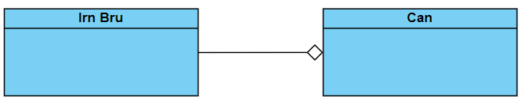
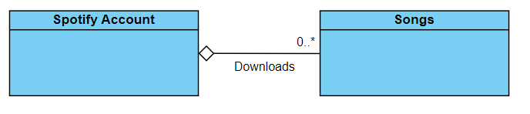
Aggregation
Classes may be part of other objects
A special form of association where one object owns another in a relationship
It’s more than just “talks to” / “communicates with”
One of the classes is the boss and owns / is in charge of the other
Despite this, the “owned” class can exist on its own if it must
It just might not be the “ideal” conditions for it to exist

Slide 8
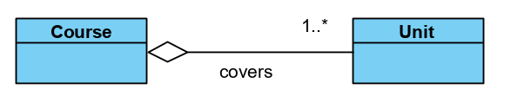
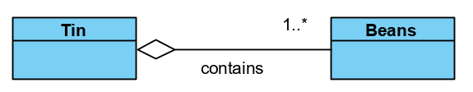
Aggregation

Slide 9
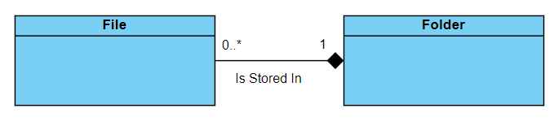
Composition
Composition is a strict form of aggregation
In this – one class still “owns” another
But it’s not possible for the class to exist by itself
A solid diamond symbol used on “whole” side to indicate composition

Slide 10
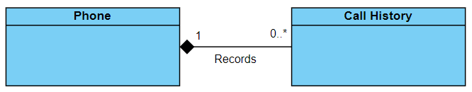
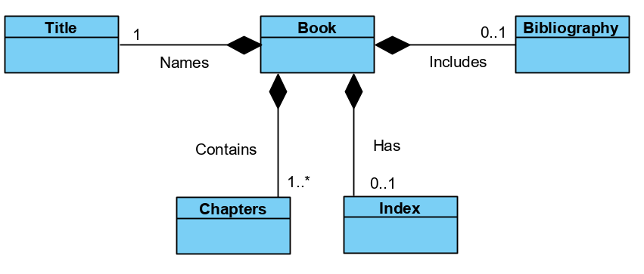
Composition
Notes:
The most common composition notation is very similar to aggregation, except that the diamond is filled in to show composition
Document is composed of one frontpage, one or more sections, and zero or one index (document may or may not have an index)
Frontpage, section & index cannot exist independently as a document ie if a document is deleted all constituent parts will be deleted
Another eg Hand is made up of up to 5 fingers and each finger is part of a hand
If the hand is removed the fingers will also be removed

Slide 11
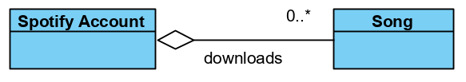
Composition
Returning to the aggregation examples – here’s why they are NOT composition examples:
Units can also be taught in isolation
without being part of a course
Students can pay for a unit
Songs don’t need to be downloaded by a user
Beans are stored in a tin yes.
But beans are even better out of the tin!!!

Slide 12
Two Stage Approach to Diagram
Initial Class Diagram:
All Classes identified
All Relationship types (inheritance, association, aggregation, composition)
Multiplicity (where useful)
Detailed Class Diagram:
All attributes (with data types)
All methods (with return types + parameters)
Visibility of attributes + methods

